Slide 1
NNFL Research Paper Assignment
Implementation by-
Jithin Sojan Kalukallam 2017A7PS0163P
Anirudh Menon 2018A3PS0344P
Ritik Rohit Bavdekar 2017B4A70349P

Slide 2

Authors
Mehdi Mizra
Present Affiliation:
Research Scientist
Deep Mind
At time of Paper Publication:
Ex-Département d’informatique et de recherche opérationnelle
Université de Montréal
Montréal, QC H3C 3J7

Slide 3
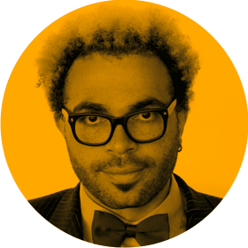
Simon Osindero
Present Affiliation:
AI Research Scientist
Deep Mind
At time of Paper Publication:
Flickr/Yahoo Inc.
San Francisco, CA 94103

Slide 4
Paper Description/Aim
To introduce Conditional Generative Adversarial Networks as a concept.
To show the basic mathematics behind the conditional GANs.
To show how to condition deep generative models(from GANs) to give output of a particular class.
To show how Conditional GANs can be used for uni-modal and multi-modal learning.
In short, the paper was an attempt to introduce the concept that extra information can be used to direct the generative/discriminative process of a GAN.
Note: Most pictures/equations are taken from the given paper: https://arxiv.org/abs/1411.1784

Slide 5
Method
Unimodal Learning: MNIST Handwritten Digits Dataset was used in the CGAN model. A one hotkey vector corresponding to the class label was used as a condition along with noise(latent vector) as input to the generator which produced handwritten digits. The discriminator gets the condition vector and the fake/real image as input.
Multimodal Learning: MIR-Flickr 25K Dataset was used with Image Tags as the generator’s output. The idea of the model was to send the image as a condition and get the tags corresponding to that image.

Slide 6
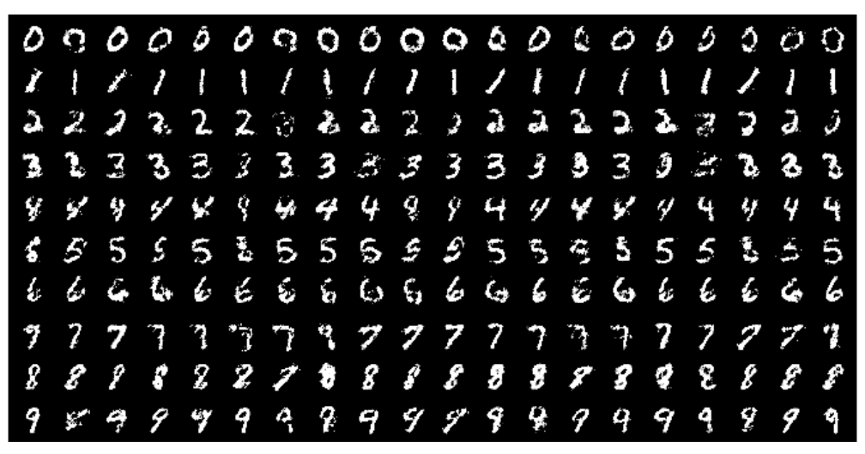
Final Outcome
Uni-Modal:The generative network successfully learnt how to generate the handwritten images based on the class label(condition).This was a proof of concept with the Parzen log likelihood estimation not comparable to the other generative models.
In the image below conditions were used to generate images of a particular class.

Slide 7
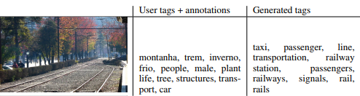
Final Outcome
Multimodal: The generative network was shown to generate tags for the given image comparable to tags given by human beings. It showed great promise in image tagging models for the future.
In the image below User Tags was part of the training dataset for the image and Generated Tags were generated by the Generator

Slide 8
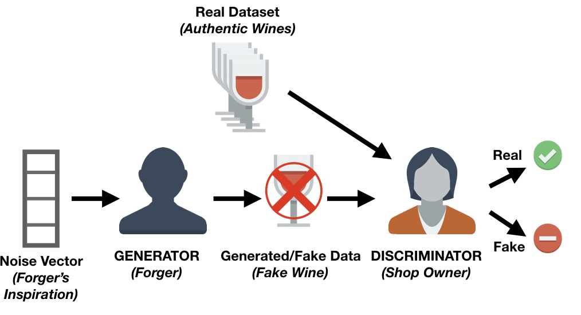
Generative Adversarial Networks: Concept
GANs are a novel way to train deep learning-based Generative Models.
The architecture comprises of a Generator and a Discriminator model.
The Generator model generates new examples that are ideally indistinguishable from the dataset examples.The Discriminator model is responsible to classify a given image as either real(from the dataset) or fake(from the generator).
The 2 models compete with each other using a 2 player min-max game.
In an unconditional generative model,theres is no control on modes of data being generated.
Image credits:https://www.datacamp.com/community/tutorials/generative-adversarial-networks

Slide 9
Conditional GANs: The concept
Conditional GANs are extended versions of GANs where the generator and discriminator are conditioned with some extra information y.
The generator learns a different distribution for each class label. Input is the noise and condition, they can be combined using concatenation.
The conditioning vector could be a class label,some part of data or even data from different modality. At times instead of sending exact data like image or text it can be converted into an embedding vector which represents the data.
The discriminator also learns a different distribution based on each class label.

Slide 10
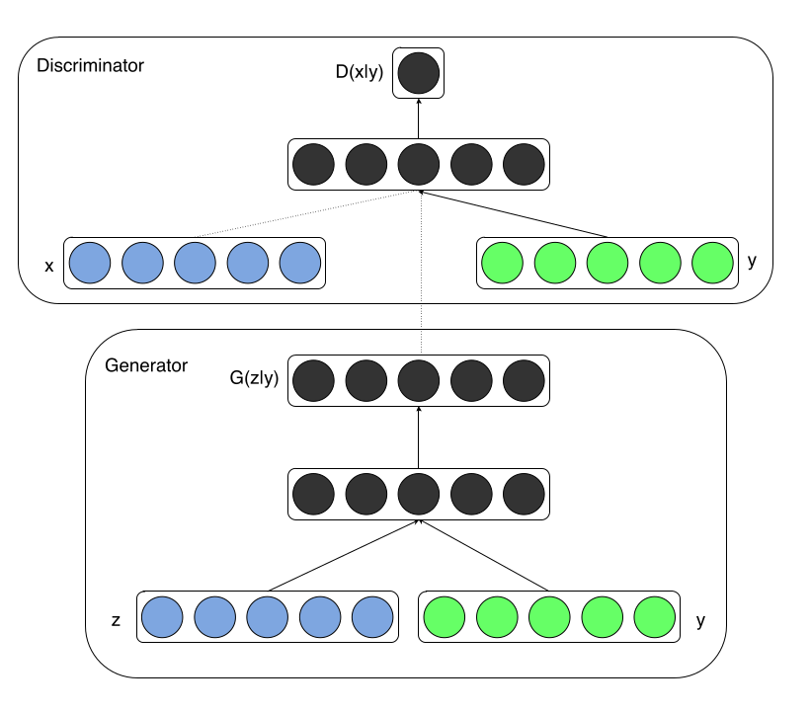
Basic Architecture of conditional GANs

Slide 11
Architecture
Unimodal: A noise prior and the condition(10d one hot vector) was mapped to a single layer with ReLU activation, which was combined to another hidden ReLU layer followed by an output sigmoid layer.
The discriminator maps the image and the condition to maxout layers each, which is combined into a joint maxout layer followed by a sigmoid layer for output.
Multi-Modal:The conditioning vector is a 4096 dimensional vector(embedding of the image) and the gaussian noise is 100 dimensional vector.They are sent to the generator to give a 200 dimensional output(embedding of a word). This embedding is sent straight to the discriminator as fake tags. Embeddings of the tags from the dataset are sent to the discriminator as real tags.
The embeddings can be generated from GloVe or Word2Vec.

Slide 12
Objective Function
The generator and discriminator play a minimax game as in normal GANs, except, as discussed, here the objective function is conditioned on y, the extra information.

Slide 13
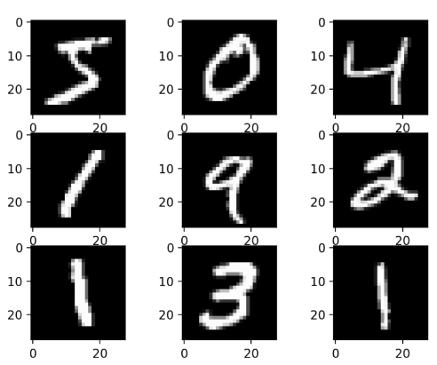
Dataset Details: Unimodal - MNIST Handwritten Digits
Modified National Institute of Standards and Technology Dataset
The MNIST Handwritten Digits Dataset is a standard dataset used in computer vision and deep learning.
The dataset has 60,000 , 28x28 pixel grayscale images of handwritten digits between 0 and 9.

Slide 14
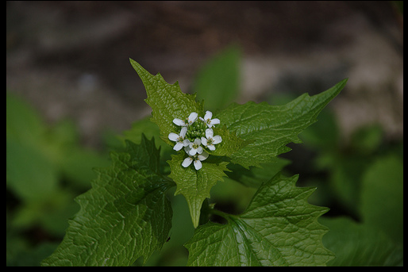
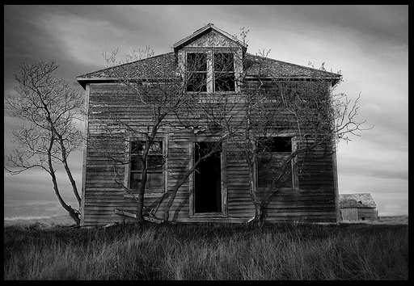
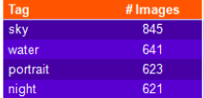
Dataset Details: Multimodal
The MIRFLICKR 25k dataset is a dataset of 25000 images downloaded from the social photography site flickr. Each image has been given multiple tags by users(User metadata).
Dataset had to be preprocessed with images having multiple tags being repeated, and a directory being built with each subdirectory including picture having a specific tag
Image credits:https://press.liacs.nl/mirflickr/

Slide 15
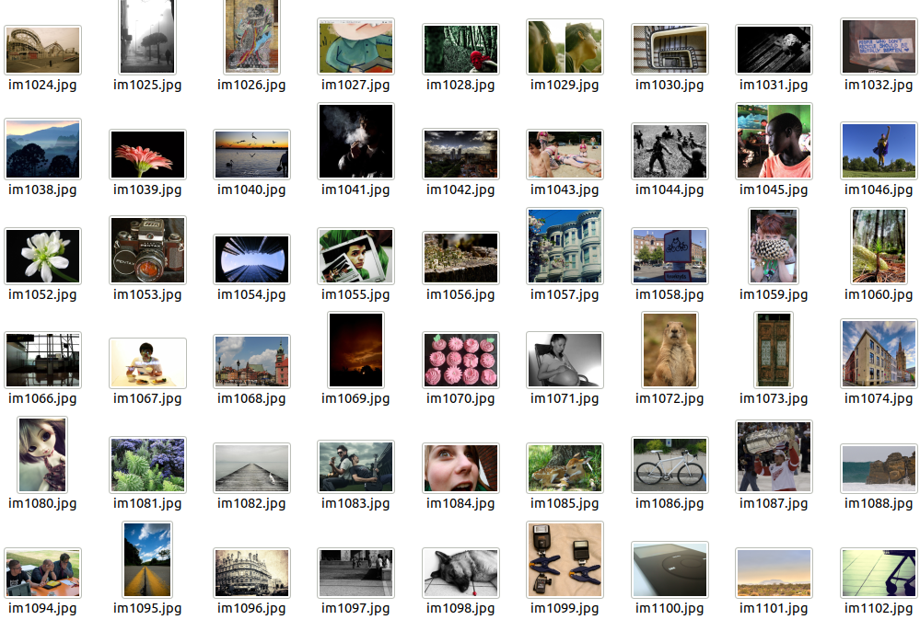
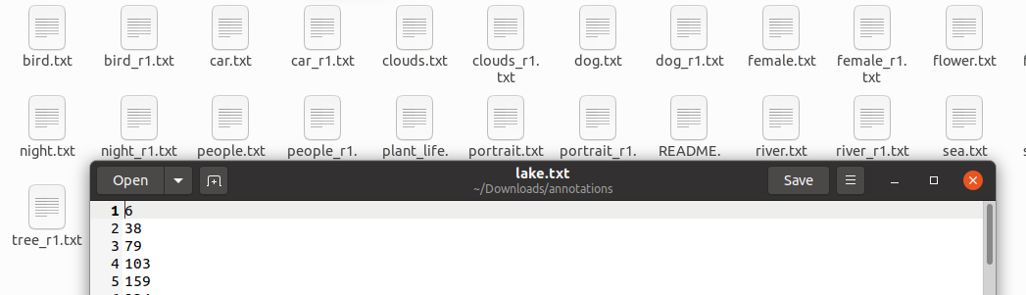
MIR-FLICKR 25k
Annotations for tag “Lake”
Images

Slide 16
Unimodal cGAN- Implementation Details
Implementation was done in keras. Two different models were implemented. First was the closest model to the model described in the paper. The second model is an improvement over the model, which was done to get better results.(First model was implemented in 2014 so many improvements could be made to increase convergence speed and computational costs).
First model: Architecture was as described in the paper.
Second model: Architecture has an extra hidden layer and uses Adam optimizer(not SGD).

Slide 17
Pseudo code: Model 1
def buildGen():
noise_input = Input(shape=(latentVectorSize,))
noise_dense = Dense(200,LeakyReLU,Dropout=0.5)(noise_input)
label_input = Input(shape = (1,))
label_onehot = OneHotEncode()(label_input)
label_dense = Dense(1000,LeakyReLU,Dropout=0.5)(label_onehot)
mergeLayer = contatenate([noise_dense,label_dense])
merge_dense = Dense(1200,LeakyReLU,Dropout=0.5)(mergeLayer)
finalLayer = Dense(784,Sigmoid)(merge_dense)
finalLayerOutput = Reshape(shape=(28,28,1))(finalLayer)
return Model(inputs=[noise_input,label_input],output=finalLayerOutput)
def buildDisc():
img_input = Input(shape=(28,28,1))
img_input_flatten = Flatten()(img_input)
Img_dense = Dense(240,LeakyReLU,Dropout=0.5)(img_input_flatten)
label_input = Input(shape = (1,))
label_onehot = OneHotEncode()(label_input)
label_dense = Dense(1000,LeakyReLU,Dropout=0.5)(label_onehot)
mergeLayer = concatenate([img_input,label_input])
merge_dense = Dense(240,LeakyReLU,Dropout=0.5)(mergeLayer)
finalLayerOutput = Dense(1,Sigmoid)(merge_dense)
return Model(inputs=[img_input,label_input],output=finalLayerOutput)

Slide 18
Pseudo code :Model 2
def buildGen():
model=Sequential()
AddLayer(Dense,LRelu, ,outputdim=256,,inputdim=latentVectorSize)
BatchNorm()
AddLayer(Dense,LRelu, outputdim=512)
BatchNorm()
Dropout(0.5)
AddLayer(Dense,tanh)
noise=Input(latentVectorSize)
label=Input(shape(10,))
label_embedding=ConvertOneHotVector(label)
input=multiply(label_embedding,noise)
def buildDisc():
model=Sequential()
AddLayer(Dense, LRelu, ,outputdim=512,inputdim=prod(imgshape))
AddLayer(Dense, LRelu, outputdim=512)
Dropout(0.5)
AddLayer(Dense, sigmoid,outputdim=1)
img=Input(img_shape)
label=Input(shape(10,))
label_embedding=ConvertOneHotVector(label)
flat_img= Flatten()(img)
model_input=multiply([flat_img,label_embedding])

Slide 19
Pseudo code common(Combined Model)
def Combined():
optimizer=SGD()
disc=buildDisc()
gen=buildGen()
img=gen(latentVec,condition)
discriminator.trainable=False
check=disc(img,condition)
model.compile(loss=binarycrossentropy)
Other Functions:
def train(epochs, batch_size,save_interval) # Used to train model for ”epochs” with batch_size
def save_model() ## Saves all 3 models in a folder named model
Def loss_plot(): #Plots the loss curves for generator and discriminator
Def save_imgs(epoch): # Saves all the images after epoch epochs
def pred(n): # gives n predictions. n//num_of_classes for each class.
def genImagesForCheck(): ## Generates images for visualisation
def load_model(epoch=0): ## loads previous model. Specify epoch to start training from epoch+1
def callParzen(cgan,n) ## Gaussian Parzen log likelihood for n generated images.

Slide 20
Multimodal Implementation
Implementation was done in keras. The condition is a 4096 dimensions image embedding vector. It was created by feeding in an image to VGG19 with the last layer popped off. Pre-trained imagenet weights were used.
The tags are converted into a 200 dimension embedding vector using GloVe word embeddings.
The 200d noise dimension and the 4096 dimension condition is sent as input to th generator. Output of generator is the fake for discriminator and embedding of tag from User meta data is real.
Training of cGANs is done

Slide 21
Pseudo code Multimodal
def buildGen():
model=Sequential()
AddLayer(Dense,LRelu, ,outputdim=256,,inputdim=latentVectorSize)
BatchNorm()
AddLayer(Dense,LRelu, outputdim=512)
BatchNorm()
AddLayer(Dense,LRelu, outputdim=1024)
BatchNorm()
AddLayer(Dense,tanh)
noise=Input(latentVectorSize)
image=Input((4096,))
model_input=multiply(noise,image)
label= model(model_input)
def buildDIsc():
model=Sequential()
AddLayer(Dense,LRelu, ,outputdim=512,,inputdim=4296)
AddLayer(Dense,LRelu, outputdim=512)
Dropout(0.4)
AddLayer(Dense,LRelu, outputdim=512)
Dropout(0.4)
AddLayer(Dense,1,sigmoid)
wordvec=Input((200,))
imageVec=Input((4096,))
model_input=Concatenate(axis=1)([imageVec,wordvec])
validity=model(model_input)

Slide 22
Pseudo Code common(Combined Model)
def cosine_similarity():
def train(epochs,batch_size, sample_interval):
def lossplot(epoch_array,g_loss_array,d_fake_loss_array,g_fake_loss_array):
def Combined():
optimizer=Adam()
disc=buildDisc()
gen=buildGen()
noise=Input(latent_dim)
img=Input(img_shape)
label=generator([noise,img])
img=gen(latentVec,condition)
discriminator.trainable=False
check=disc(img,condition)
model.compile(loss=binarycrossentropy)

Slide 23
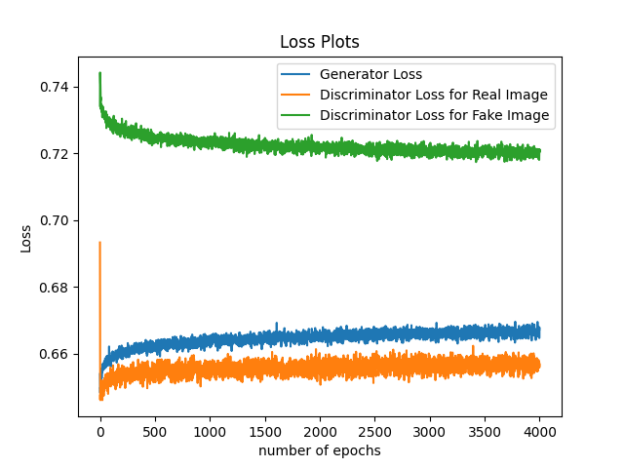
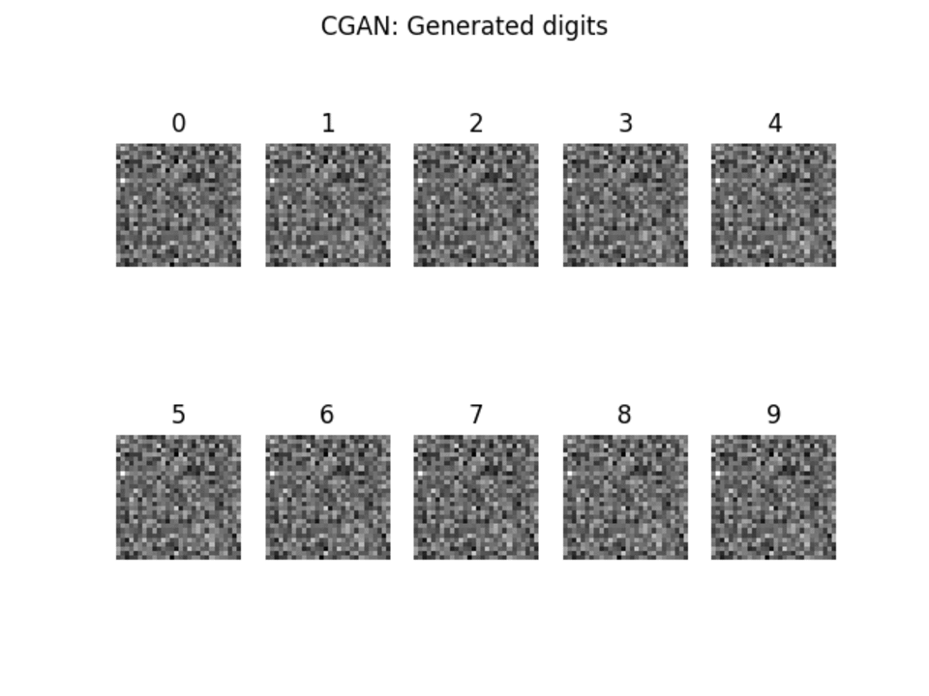
Unimodal Results- Model 1 after 4000 epochs
Model 1’s generator couldn’t learn the data distribution in 4000 epochs. In the later epochs some learning is visible
GIF of Predictions:different epochs

Slide 24
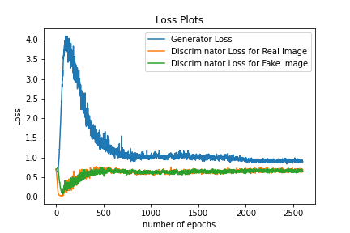
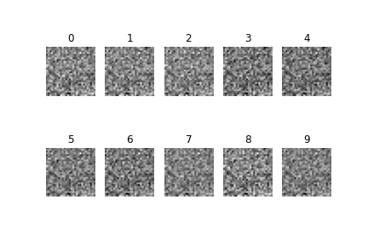
Unimodal Results: Model 2
The improved could learn at a much faster rate. We attribute it to a better optimizer(Adam) and leakyReLu function.
GIF of Predictions:different epochs

Slide 25
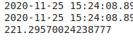
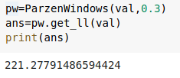
Gaussian Parzen log likelihood window
Model | Estimate Value
Model 1
Model 2

Slide 26
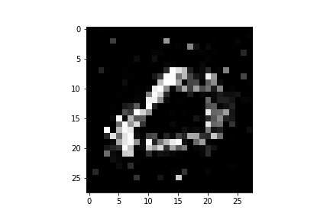
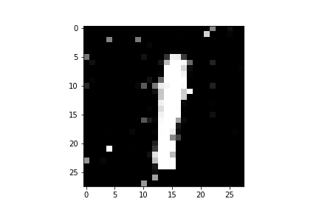
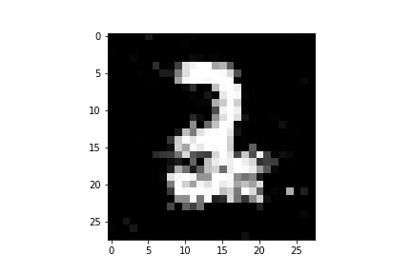
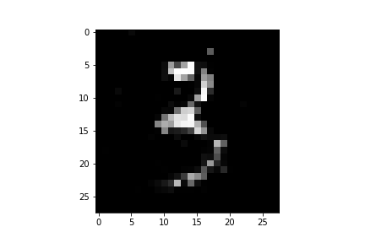
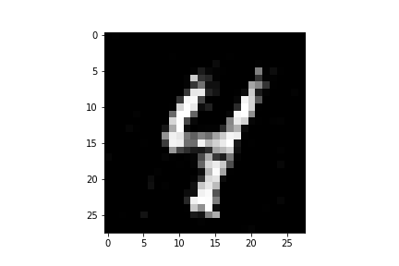
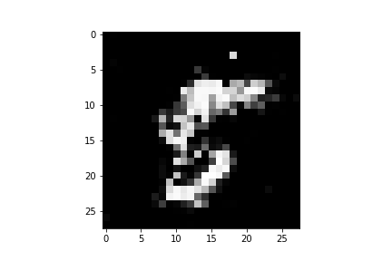
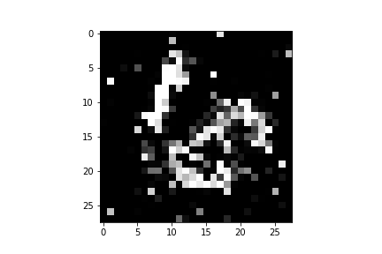
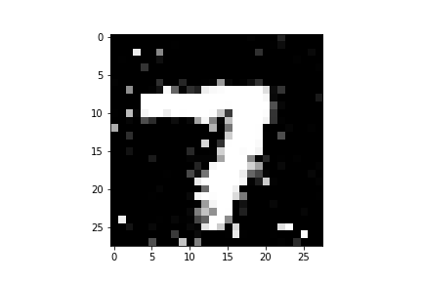
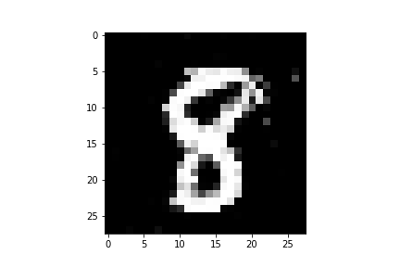
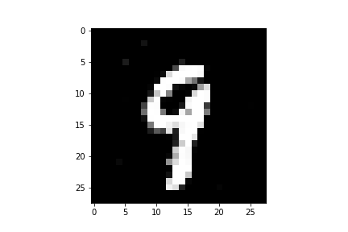
A few good and poor predictions
Good Predictions: 1,3,4,7,8,9
Poor Predictions: 0,2,5,6

Slide 27
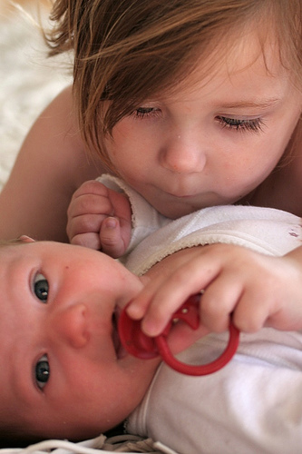
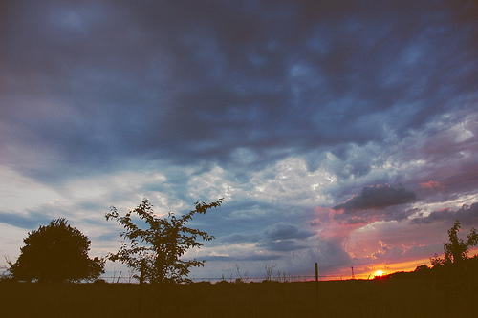
Multimodal: Results(Cosine Similarity)
Tags found:
Theme, portrait, tree, eternity
Tags found:
Female, male, tydings,intersex

Slide 28
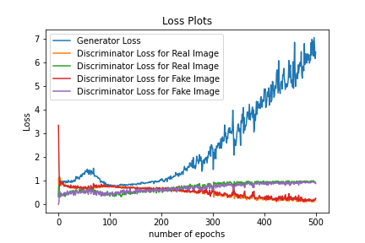
Multimodal Loss Curve
Note:Due to computational restraints the Network was trained for only 500 epochs

Slide 29
Challenges Faced in Implementation
Data cleaning and preprocessing for Flickr 25K dataset. The annotations and images were present in different files. Linking and loading was difficult
Dataset size (3.2GB): We had to download the entire zip file and then manually make subsets.
Computational costs. We had to run our code on Google Colab to meet computational requirements. This was also affected by the variability in the processing speed in Colab.
Finding literature related to Gaussian Parzen log likelihood estimate.
MaxOut is no longer supported by Keras. The original paper implementation used it in the unimodal part so we had to use an alternative.

Slide 30
Future Scope
Conditional GAN is a novel technique to train generative models to generate output of a particular class.
Ever since the paper was released in 2014 a wide variety of applications have been found.
Several researchers have built on the idea and a lot of variants of cGAN are available.
cGANs can be used for a variety of different computer vision tasks like realistic human face generation and image tagging.
Conditional GANs are extensively trained whenever a generative model with control on output is required

Slide 31
Experience of Assignment
Built a complete Neural Network from scratch
Learnt how to implement models in Keras
Learnt how to use google colabs for python files.
Learnt how to implement GANs.
Learnt how to work on real world deep learning problems
Learnt a lot in numpy and pandas while preprocessing and postprocessing data
Had a lot of fun implementing the models.

